Slide 1
Examples
Ngan Nguyen

Slide 2
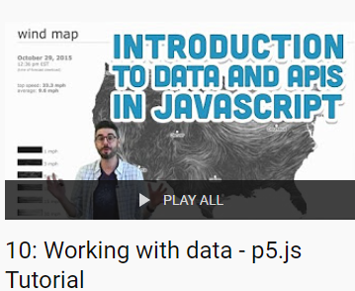
Contents
https://www.youtube.com/playlist?list=PLRqwX-V7Uu6a-SQiI4RtIwuOrLJGnel0r
Camera
Weather
News feed NYTime
Music player and Spotify
https://editor.p5js.org/Zipexpo/sketches/vIcRDNmAa
https://editor.p5js.org/Zipexpo/sketches/a0txcOe-8
https://editor.p5js.org/Zipexpo/sketches/lZdpjJSYS
Gridstack and Color picker
https://editor.p5js.org/Zipexpo/sketches/Kr2_gOl5C
https://editor.p5js.org/Zipexpo/sketches/Ue0gG-r6l
https://github.com/gridstack/gridstack.js
https://www.cssscript.com/color-picker-pro/
Calendar
Iframe calendar: https://editor.p5js.org/Zipexpo/sketches/nXfo9wyRr
Google calendar custom: https://editor.p5js.org/Zipexpo/sketches/Qs7OdzSPC

Slide 3
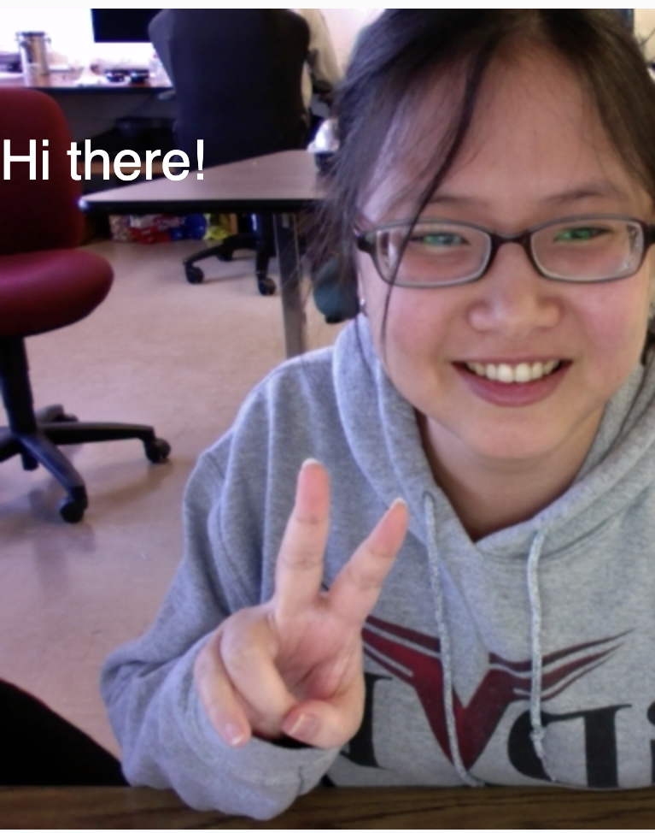
CAMERA
https://editor.p5js.org/Zipexpo/sketches/vIcRDNmAa

Slide 4
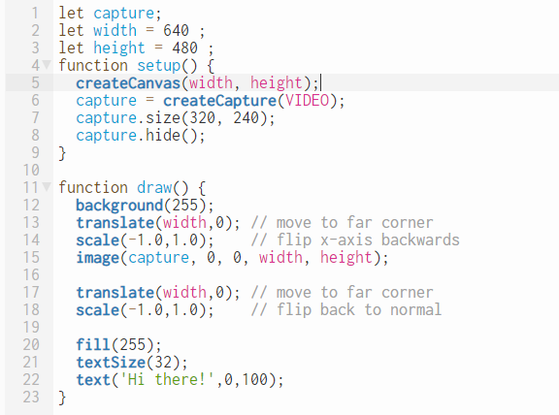
CAMERA
https://editor.p5js.org/Zipexpo/sketches/vIcRDNmAa
Setup camera
Flip camera
Flip canvas back to normal

Slide 5
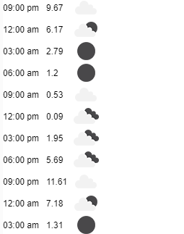
Weather
https://editor.p5js.org/Zipexpo/sketches/a0txcOe-8

Slide 6
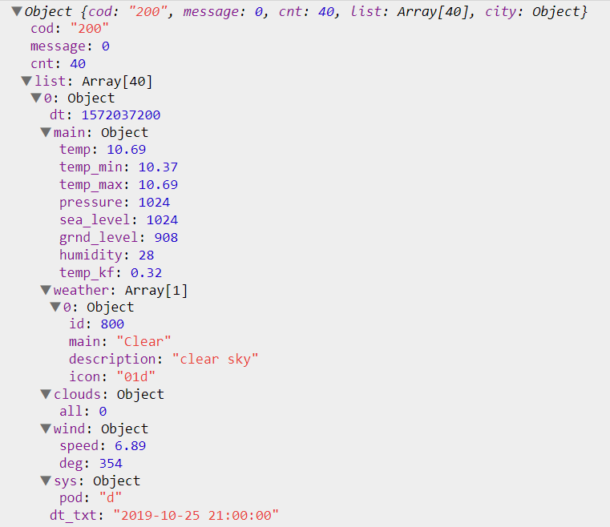
WEATHER
https://editor.p5js.org/Zipexpo/sketches/a0txcOe-8
Temperature
Weather Icon
Date and Time

Slide 7
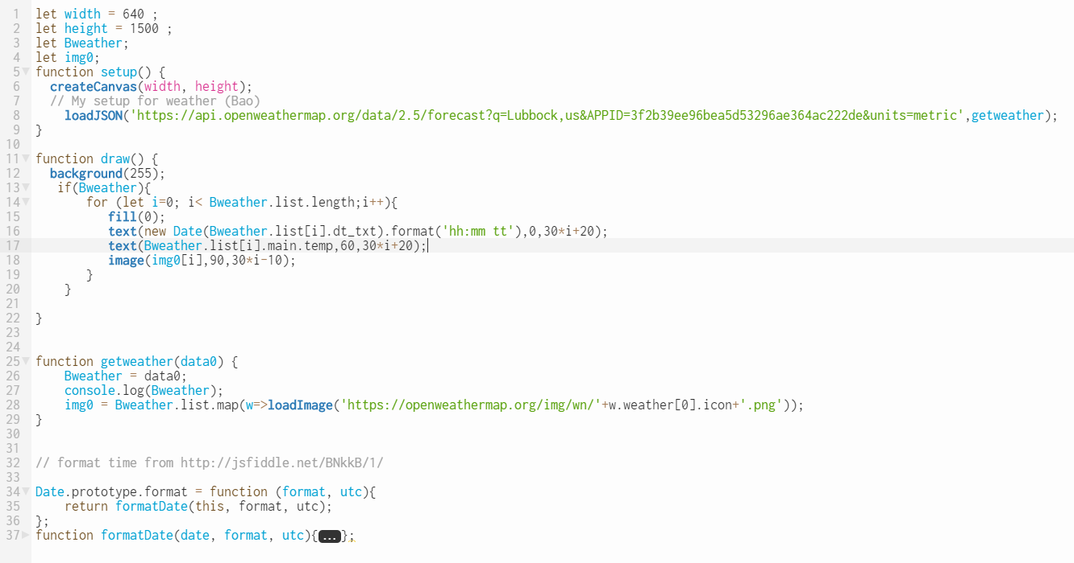
WEATHER
https://editor.p5js.org/Zipexpo/sketches/a0txcOe-8
Load weather
Draw detail
Format time
Get temperature
Load weather icon
Assign data and load image

Slide 8
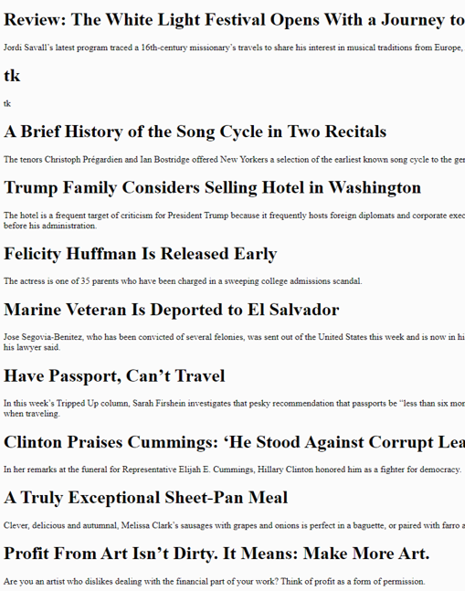
NYTIME
https://editor.p5js.org/Zipexpo/sketches/lZdpjJSYS

Slide 9
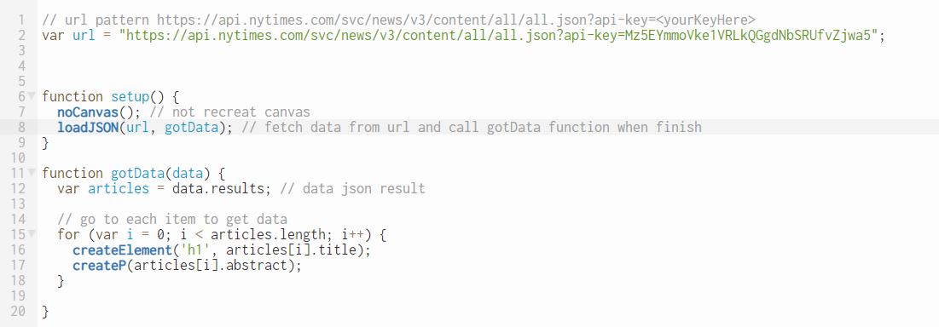
NYTIME
https://editor.p5js.org/Zipexpo/sketches/lZdpjJSYS
Sign In
Choose API
Get API Key
Get API URL

Slide 10
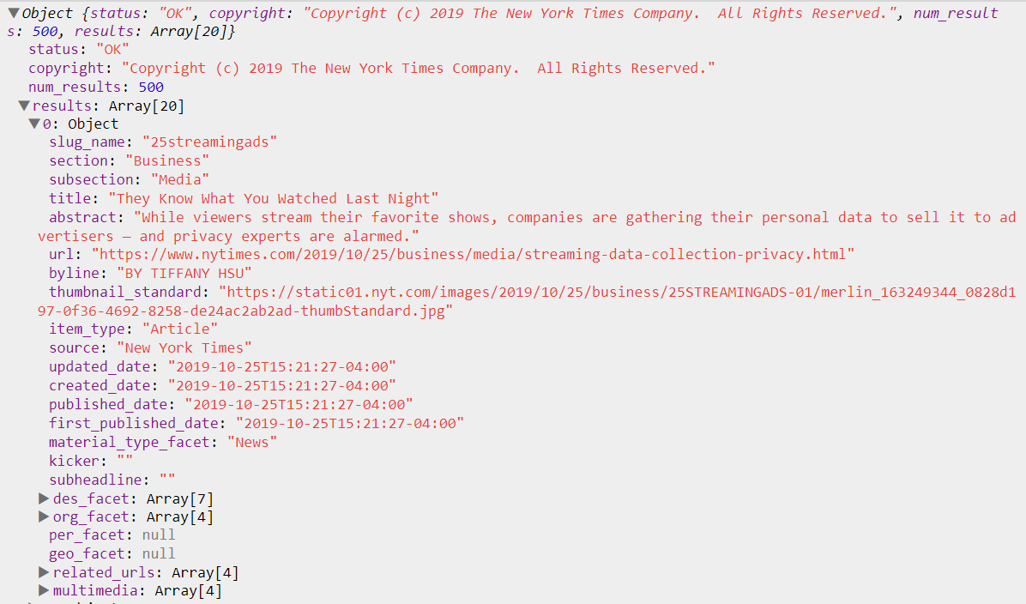
NYTIME
https://editor.p5js.org/Zipexpo/sketches/lZdpjJSYS

Slide 11
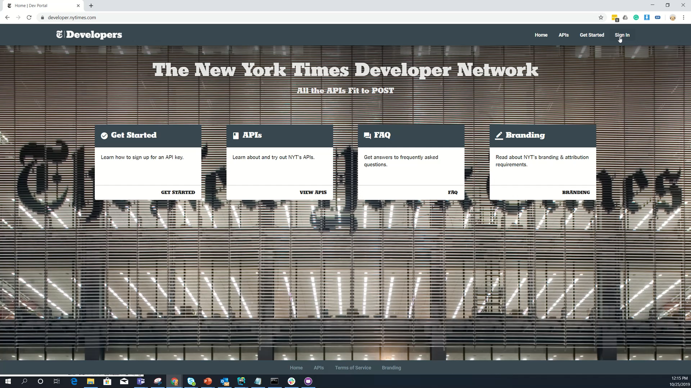
NYTIME
https://editor.p5js.org/Zipexpo/sketches/lZdpjJSYS
How to sign in and get API key
https://developer.nytimes.com

Slide 12
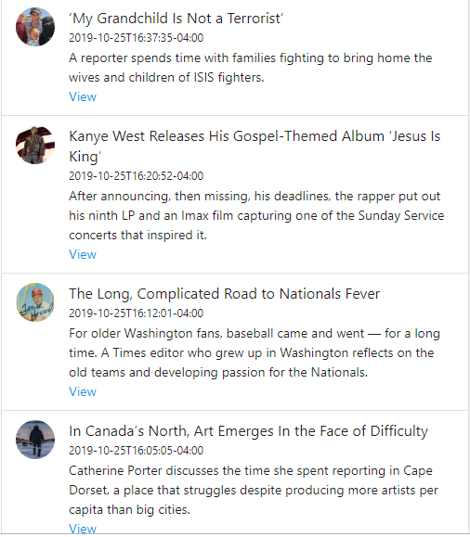
NYTIME
https://editor.p5js.org/Zipexpo/sketches/EJRN1Zwu8
with style

Slide 13
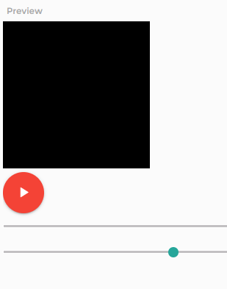
Music player
https://editor.p5js.org/Zipexpo/sketches/Kr2_gOl5C

Slide 14
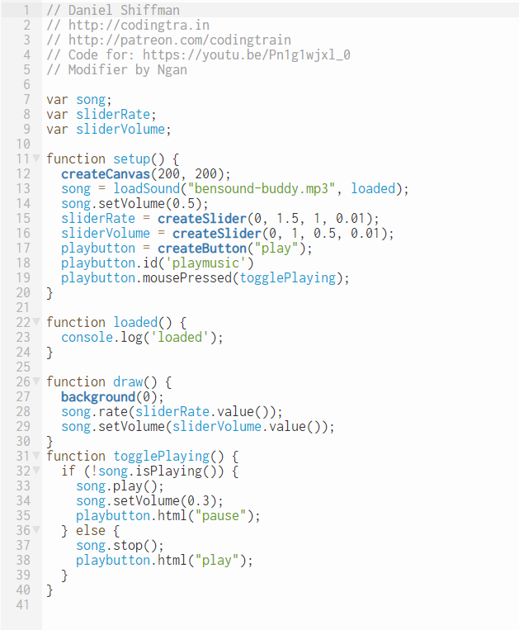
MUSIC PLAYER
https://editor.p5js.org/Zipexpo/sketches/Kr2_gOl5C

Slide 15
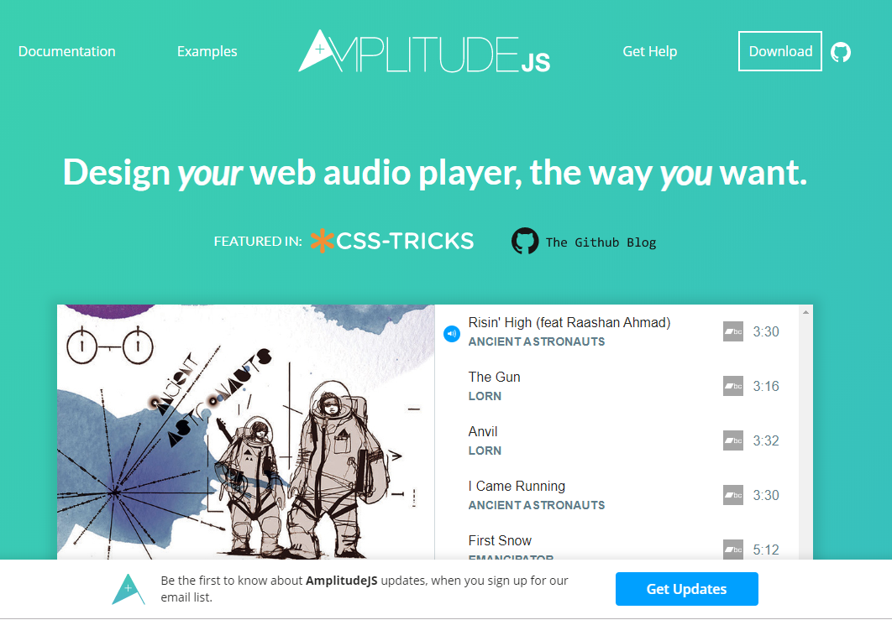
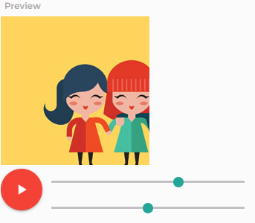
MUSIC PLAYER
https://editor.p5js.org/Zipexpo/sketches/UyqyAJXjr
https://521dimensions.com/open-source/amplitudejs

Slide 16
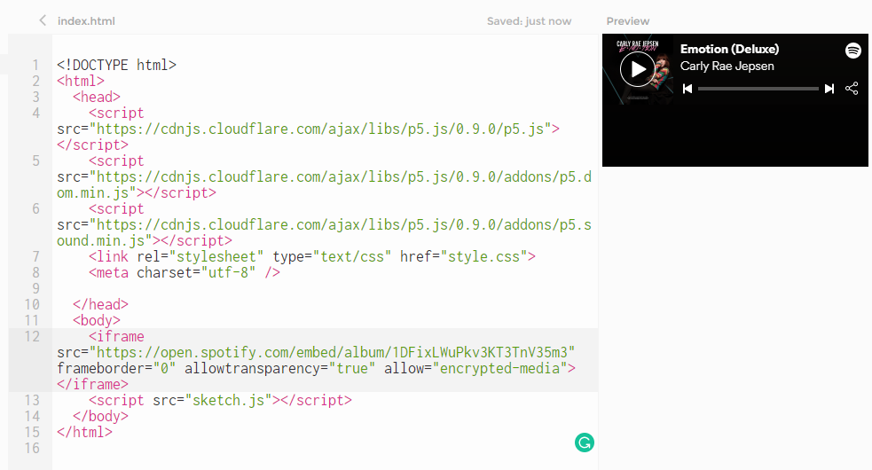
Spotify
https://editor.p5js.org/Zipexpo/sketches/Ue0gG-r6l
https://developer.spotify.com/documentation/widgets/guides/adding-a-spotify-play-button/

Slide 17
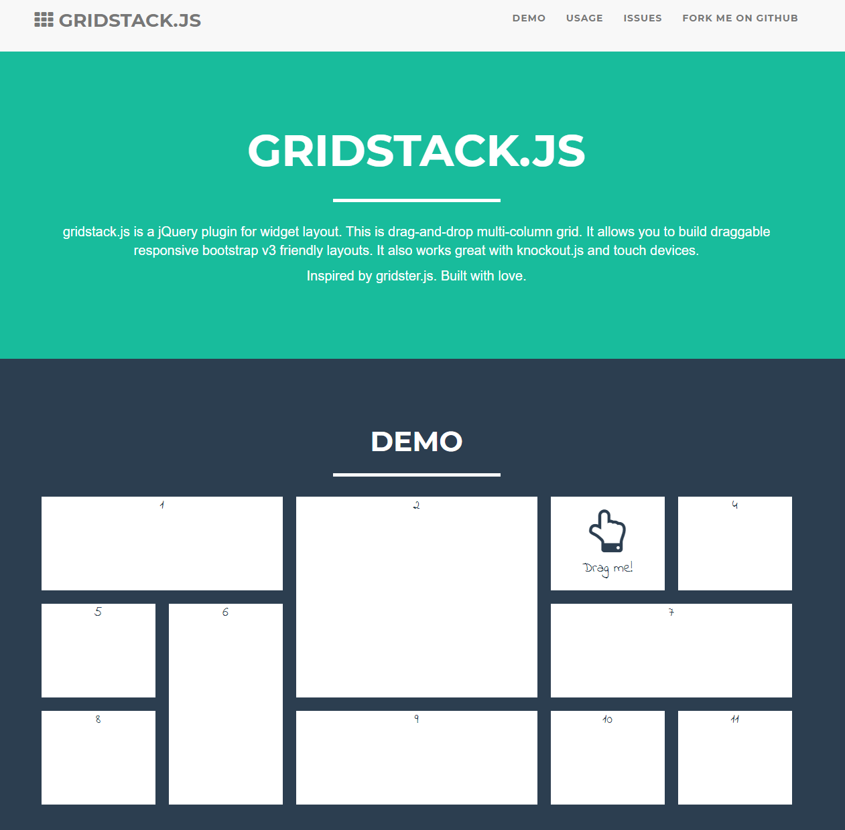
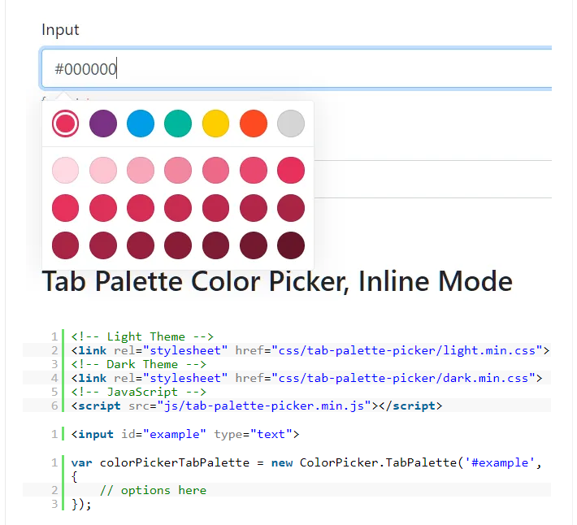
Other materials
https://github.com/gridstack/gridstack.js
https://www.cssscript.com/color-picker-pro/

Slide 18
Calendar
Iframe calendar: https://editor.p5js.org/Zipexpo/sketches/nXfo9wyRr
Google calendar custom: https://editor.p5js.org/Zipexpo/sketches/Qs7OdzSPC

Slide 19
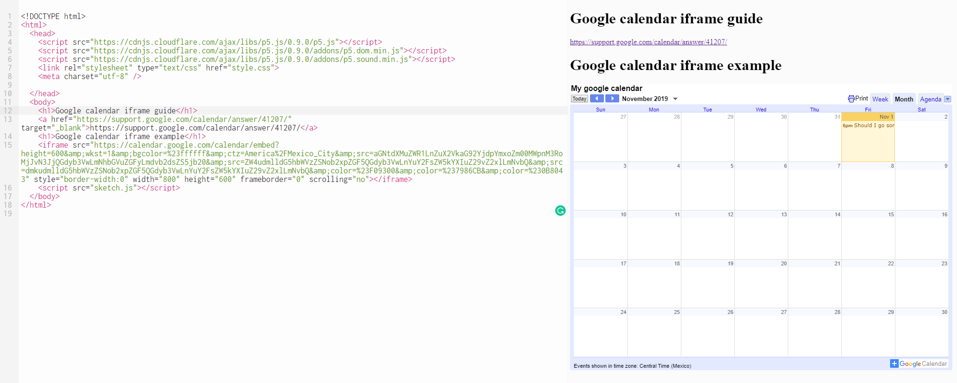
CALENDAR
https://editor.p5js.org/Zipexpo/sketches/nXfo9wyRr

Slide 20
CALENDAR
https://editor.p5js.org/Zipexpo/sketches/Qs7OdzSPC
Set up api
https://github.com/iDataVisualizationLab/CS3366/tree/master/slides/setupgoogle.mp4

Slide 21
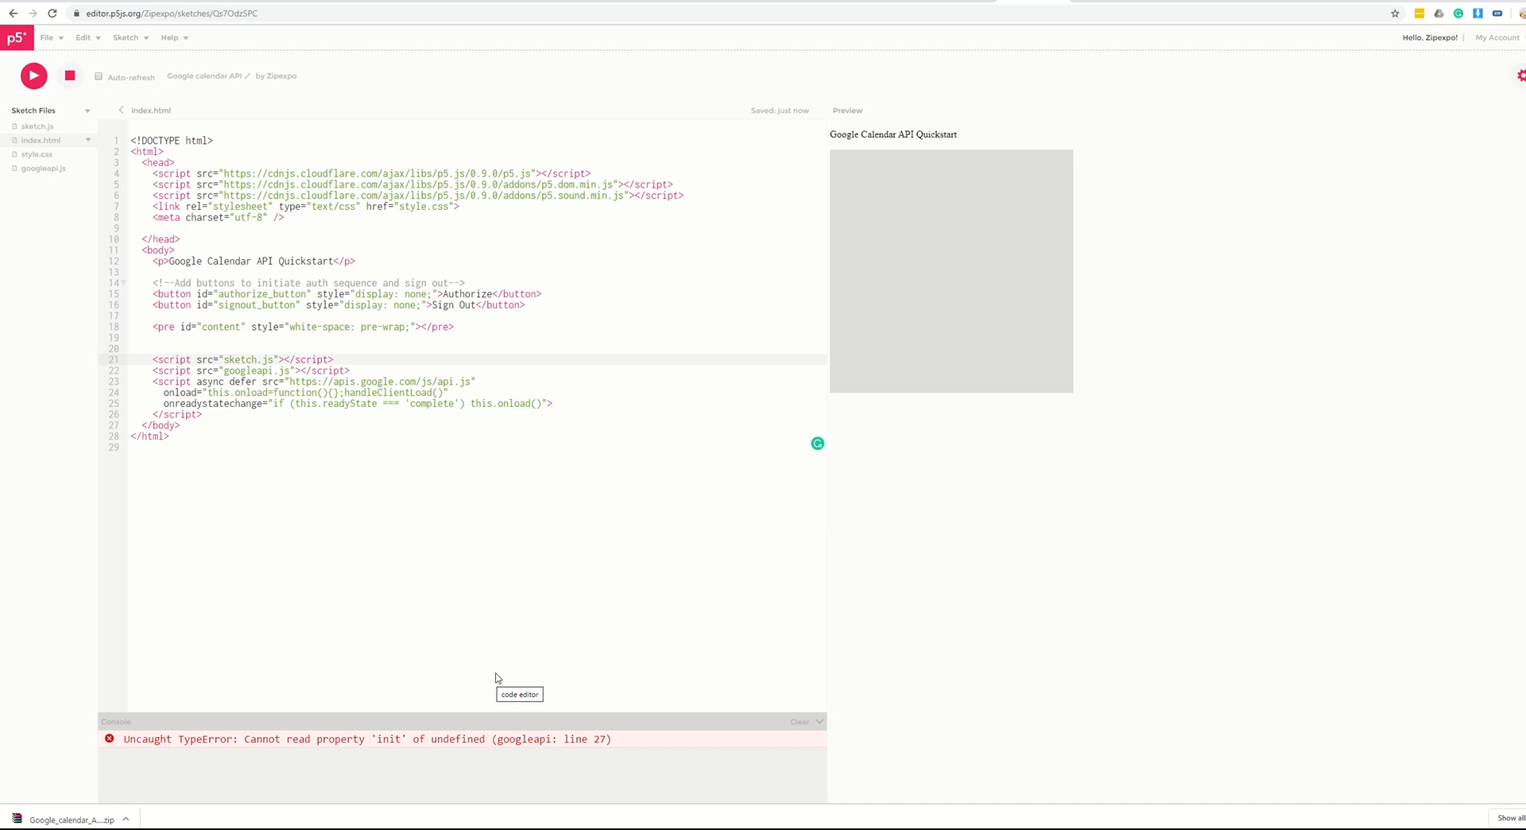
CALENDAR
https://editor.p5js.org/Zipexpo/sketches/Qs7OdzSPC
Download to local and fix error

Slide 22
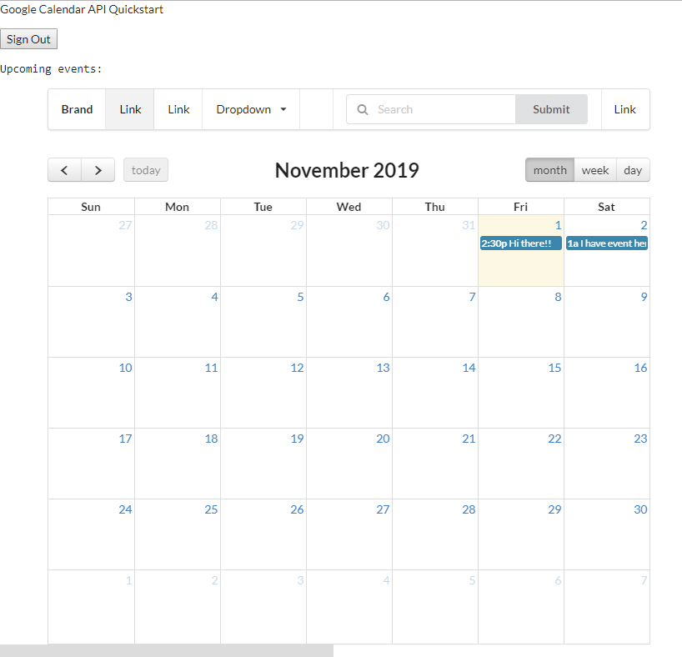
CALENDAR
https://editor.p5js.org/Zipexpo/sketches/1Im9_Yymj
UI and google api

Slide 23


THANK YOU
NGAN NGUYEN
Ngan.V.T.Nguyen@ttu.edu

